Slide 1

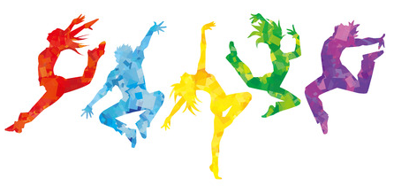
Dance Related Alphabet Workout
Challenge
Task (30-40 minutes):
Complete the 10 words in the box below, plus the challenge word.
Each letter has a specific exercise (see next slide)
Use your whiteboard or piece of paper to write the word out and jot down what exercise you need to complete.
For example:
Solo e.g. S = Russian Twists x 10, O = Squats x 15, L = Alternate lunges x 10, O = Squats x 15
Words:
Space
Group
Canon
Rhythmical
Counts
Challenge Word:
You decide your final word. However, it needs to be dance related.
Complete your final word.
When you have finished:
Upload the challenge word you did including what the exercises were (Like the example) to class charts.
Action
Solo
Duet
Dynamic
Relationship

Slide 2
A – Burpees x 12
B – Bunny Hop x 10
C – ab crunches x 20
D – up and down plank x 10
E – squat jumps x 15
F – side plank x 10secs
G – heel flicks x 30
H –high knees x 30
I – press ups x 15
J – leg raises x 20
K –mountain climbers x 20
L – alternate lunges x 10
M – wall sit x 6o secs
N –bicycle kicks x 10
O – squats x 15
P – step ups x 30
Q – straight punches x 30
R –sit – ups x 12
S – Russian twists x 10
T – star jumps x 20
U – plank x 20secs
V – v-sit hold x 10
W – quick feet x 20
X – bicycle crunches x 10
Y – arm circles forward x 10
Z – arm circles backward x 10

